Slide 1

Title of Seminar
“HIGHLY AUTOMATED VEHICLES AND SELF-DRIVING CARS ”
Bhujbal Knowledge City
MET Institute of Engineering
Presented By :-
25 – Siddesh Balasaheb Kankrale
Guided By –
Prof. P.E.Patel
Department of Information Technology

Slide 2
Bhujbal Knowledge City
MET Institute of Engineering
Contents :
Introduction
Literature Survey
Methodology and Implementation
Results discussed if any
Applications
Conclusion
References
*

Slide 3
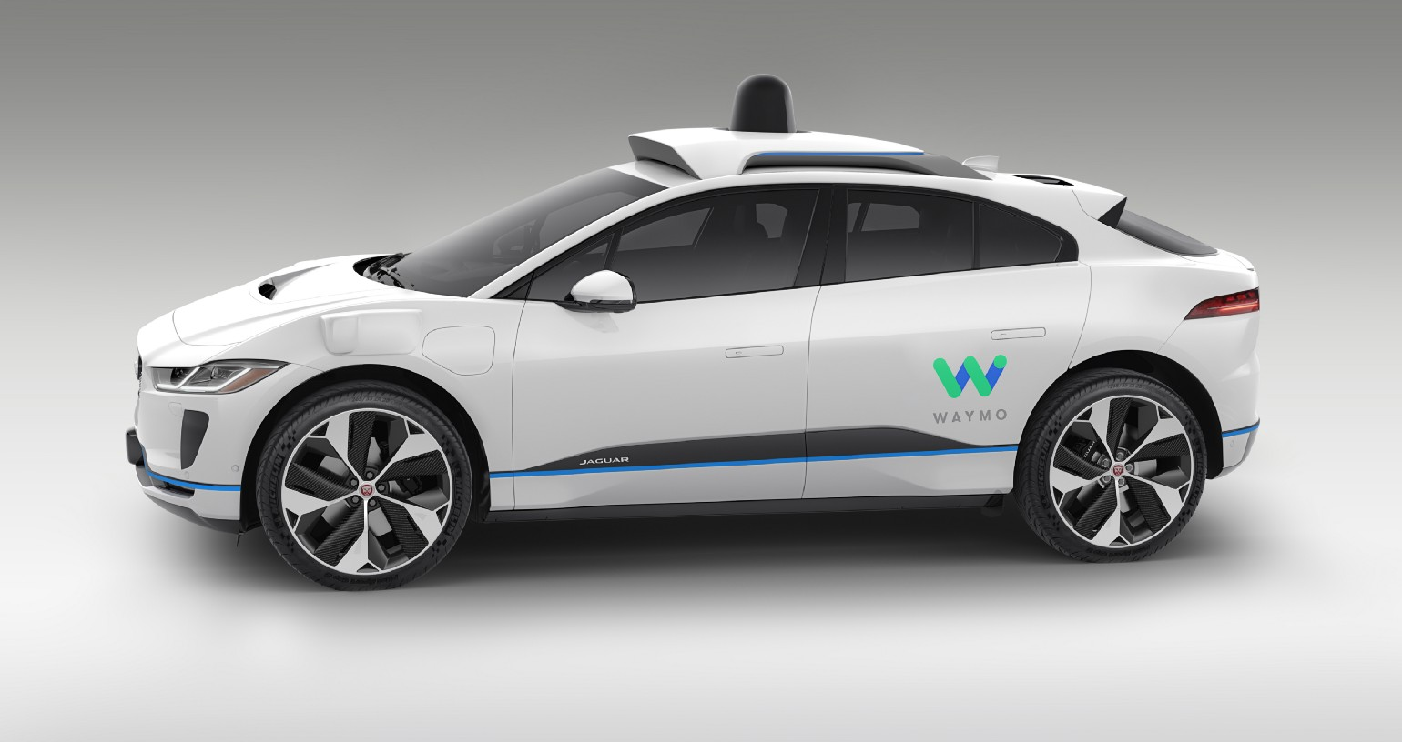
Bhujbal Knowledge City
MET Institute of Engineering
Introduction :
Automated vehicles, commonly referred to as self-driving cars, represent a groundbreaking innovation in the field of transportation. These vehicles are equipped with advanced sensors, artificial intelligence, and computer systems that allow them to navigate and operate without human intervention. The development of self-driving cars holds the promise of safer, more efficient, and convenient transportation, potentially reducing accidents caused by human error and alleviating traffic congestion.
~JAGUAR i-pace~ by WAYMO
*

Slide 4
Bhujbal Knowledge City
MET Institute of Engineering
Levels of Automation-
● L0: no automation
● L1—driver assistance: specific functions under control
● L2—partial automation: combined function automation (e.g., adaptive cruise control)
● L3—conditional automation: automation of all critical functions with limitations (limited self-driving); the driver must be able to take control at all times
● L4—high automation: the vehicle performs all driving tasks under certain conditions; the driver may take control
● L5—full automation: the vehicle performs all driving tasks under all conditions; driver may take control.

Slide 5
Bhujbal Knowledge City
MET Institute of Engineering
Literature Survey :
Author Name | Objective | Key Findings
1- Smith, J- 2022 | To review current technologies in AVs | Identified trends in AV technology and adoption
2- Brown, A- 2021 | Analyze challenges of AV deployment | Urban infrastructure limitations and social acceptance issues
3- Johnson, R- 2020 | Investigate ML applications in AVs | ML algorithms for object recognition and decision-making
4- Kim, H- 2018 | Examine legal and ethical issues in AVs | Addressed liability concerns and ethical dilemmas
*

Slide 6
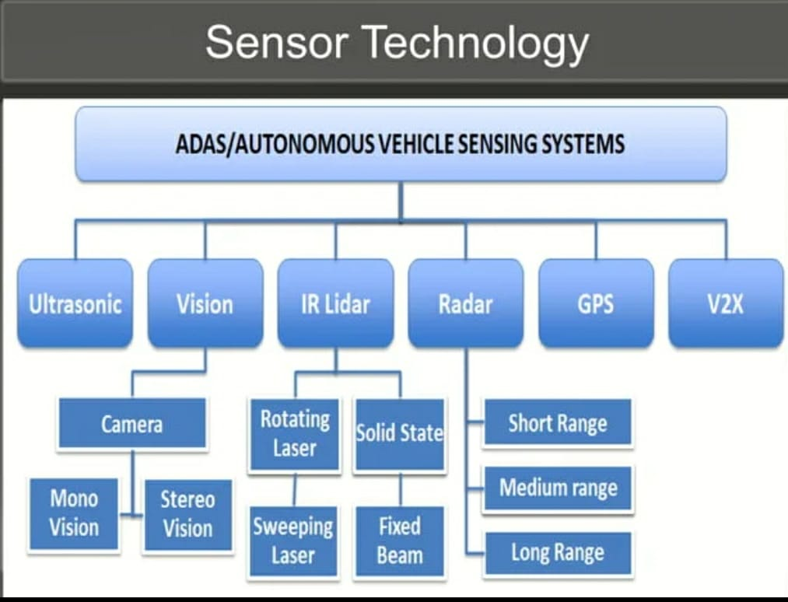
Bhujbal Knowledge City
MET Institute of Engineering
Methodology and Implementation :
*

Slide 7
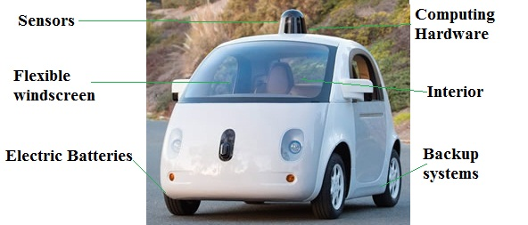
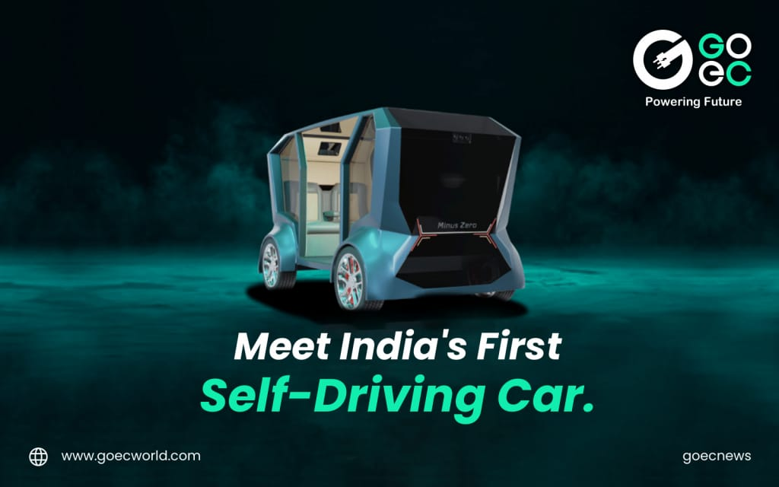
Bhujbal Knowledge City
Results :
MET Institute of Engineering
“ Google’s self-driving car “ “Z-POD”
*

Slide 8
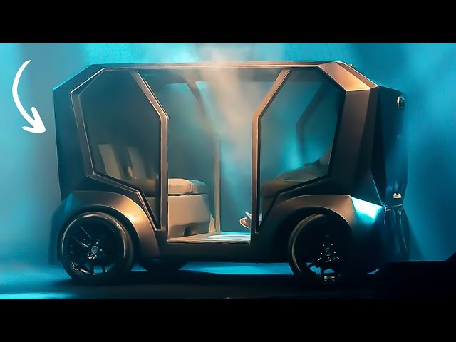
Bhujbal Knowledge City
MET Institute of Engineering
-Unlike conventional autonomous cars, the zPod does not function on the basis of light detection and ranging (LIDAR). It utilizes an array of six cameras, with four on the sides and two at the front and back.
-This concept can be applied to any existing vehicle, be it an ICE or an EV. Autonomous driving technology can be retrofitted if the car features an engine control module.
What makes zPod unique from other autonomous vehicles developed so far?
The zPod stands out from other autonomous vehicles in multiple ways. It is one of the few vehicles in the world that can run solely on camera sensors, eliminating the need for LiDARs, a big feat in the AV industry. The zPod is a perfect concept vehicle to showcase our novel approach towards AI, Nature-inspired AI, which enables it to think and act more like humans.

Slide 9
Bhujbal Knowledge City
MET Institute of Engineering
Applications :
1- Ride-Sharing and Transportation Services:
Companies like Uber are integrating self-driving cars into their fleets to offer autonomous ride-sharing services.
2-Personal Ownership:
Explore the concept of self-driving cars for personal use and their potential to change car ownership dynamics.
3-Industrial Applications:
Mention how autonomous vehicles are used in industrial settings for tasks such as material handling and mining.
*

Slide 10
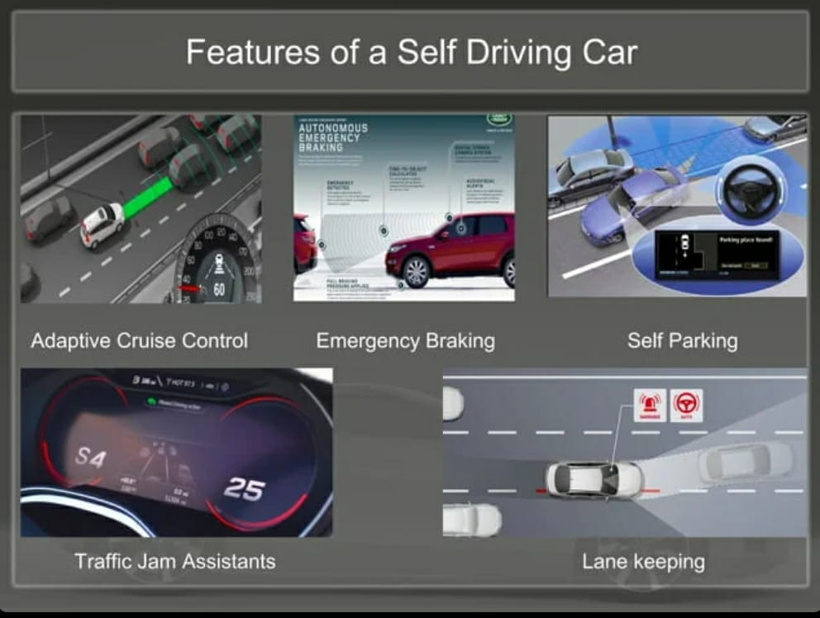
Bhujbal Knowledge City
FEATURES-
1-Adaptive Cruise Control: Adaptive cruise control (ACC) is a vehicle technology that automatically adjusts speed to maintain a safe following distance from the vehicle ahead.
2-Emergency Braking: Emergency braking is the rapid and forceful application of a vehicle's brakes to prevent a collision or respond to a sudden danger.
3-Self Parking: Self-parking is an automated feature in vehicles that allows them to park themselves without the driver's direct control.
4-Lane Keeping: Lane keeping is a technology that helps a vehicle stay within its lane by providing automatic steering corrections if it starts to drift out of the lane.
MET Institute of Engineering

Slide 11
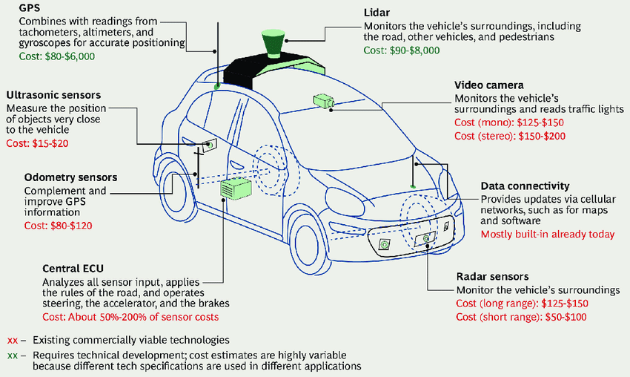
Bhujbal Knowledge City
MET Institute of Engineering
Implementation of Sensors in Cars

Slide 12
Bhujbal Knowledge City
MET Institute of Engineering
How Self Parking Works:
Sensors and Cameras: Sensors and cameras detect the car's surroundings.
Parking Space Detection: Identify available parking spots.
Control Unit: Onboard computer processes data.
Steering and Braking Control: System takes control of steering and braking.
Driver Guidance: Guides the driver through shifting gears as needed.
Real-time Monitoring: Constantly monitors the environment.
Parking Alert: Alerts the driver when parking is complete.
Driver's Role: The driver must stay attentive for potential intervention.

Slide 13
Bhujbal Knowledge City
MET Institute of Engineering
Conclusion :
In conclusion, upon addressing the mechanics of the driverless car as well as its benefits and potential issues, it is quite interesting to see how the world will actually become by the year 2040.
Sensors that are an integral part of an autonomous vehicle will become more sophisticated and will potentially have more functionality addition in the near future.
It is fascinating to see the effects this creation will have on the states in which it is legalized as well as on the people that have chosen to experiment with it.
*

Slide 14
Bhujbal Knowledge City
MET Institute of Engineering
References :
[1] D. B. O. Boesl and B. Liepert, “4 robotic revolutions—Proposing a holistic phase model describing future disruptions in the evolution of robotics and automation and the rise of a new generation r of robotic natives,” in Proc. 2016 IEEE/RSJ Int. Conf. Intelligent Robots and Systems (IROS), pp. 1262–1267.
[2] J. M. Anderson, K. Nidhi, K. D. Stanley, P. Sorensen, C. Samaras, and O. A. Oluwatola, Autonomous Vehicle Technology: A Guide for Policymakers. Santa Monica, CA: Rand Corporation, 2014.
[3] Taxonomy and Definitions for Terms Related to On-Road Motor Vehicle Automated Driving Systems, SAE International Standard
J3016, 2014.
[4] V. A. Banks, A. Eriksson, J. O’Donoghue, and N. A. Stanton, “Is partially automated driving a bad idea? Observations from an onroad study,” Appl. Ergonom., vol. 68, pp. 138–145, Apr. 2018.
[5] M. Bojarski, D. Del Testa, D. Dworakowski, B. Firner, B. Flepp, P. Goyal, L. D. Jackel, M. Monfort, U. Muller, J. Zhang, X. Zhang, J.
Zhao, and K. Zieba. (2016). End to end learning for self-driving cars. arXiv. [Online]. Available: https://arxiv.org/abs/1604.07316
[6] Road Vehicles—Functional Safety, ISO Standard 26262, 2011.
*

Slide 15
Bhujbal Knowledge City
MET Institute of Engineering
Thank You …
*

